Slide 1

Week 5 Project Update
Matthew Vu

Slide 2
Overview: Updates Made to Project
Changed the dataset to one that consists of the same data, but different is from a distributor
Cleaned the new dataset
Further performed exploratory data analysis
Univariate data exploration
Multivariate data exploration
Check for multicollinearity amongst the variables

Slide 3
Change of Dataset:
Old Dataset’s Metadata and Issues:
Name: Diabetes Health Indicators Dataset
Distributor: Alex Teboul
Description: The dataset consists of 70, 692 survey responses to the CDC’s 2015 Behavioral Risk Factor Surveillance System (BRFSS) Health Survey. It contains 21 predictor variables that are commonly known to be related to diabetes, including information on habits, behaviors, and chronic diseases. The observations contained within the dataset are balanced, meaning there is a 50-50 split between observations that have diabetes and do not. This was done by randomly sampling 35, 346 observations with and without diabetes from the original BRFSS Health Survey dataset. The original BRFSS Health Survey dataset consisted of over 400,000 observations, but this was reduced after cleaning the data.
File Type and Size: The dataset comes in the form of a 6.05 MB .csv file with 70, 692 rows and 22 columns.
Reason for use: The data consists of predictors describing each person’s habits, behaviors, and chronic disease. Also includes information on diet, high blood pressure, high cholesterol, and difficulty walking.
Issues: Since multicollinearity exists within the dataset, I will need to remove some predictors, and therefore, have less than 20 predictors to train the model on. Adding predictors from the dataset it was derived from, the BRFSS Health Survey dataset, would not be possible due to how this dataset’s distributor took random samples from the BRFSS Health Survey dataset and appending columns from the BRFSS Health Survey dataset would cause the rows (cases) to not align due to how there is no use of case ID’s or primary keys.
Citation: Teboul, Alex (2019). Diabetes Health Indicators Dataset [Data set]. kaggle. https://www.kaggle.com/datasets/alexteboul/diabetes-health-indicators-dataset?select=diabetes_binary_5050split_health_indicators_BRFSS2015.csv
New Dataset’s Metadata:
Name: Behavioral Risk Factor Surveillance System
Distributor: Centers for Disease Control and Prevention
Description: The dataset consists of 441, 456 survey responses to the CDC’s 2015 Behavioral Risk Factor Surveillance System (BRFSS) Health Survey. It contains 330 variables that are answers to the health survey. It is the raw data, uncleaned, and original dataset to which the dataset on the left was derived from
File Type and Size: The dataset comes in the form of a 516 MB .csv file with 441, 456 rows and 330 columns.
Reason for use: It is the original source of the data from the dataset on the right. Also, by using the original data and cleaning it myself, I will be able to add predictors variables that might be useful later down the road without having to worry about the rows being misaligned. The data consists of predictors describing each person’s habits, behaviors, and chronic disease. Also includes information on diet, high blood pressure, high cholesterol, and difficulty walking.
Citation: Centers for Disease Control and Prevention (2018). Behavioral Risk Factor Surveillance System [Data set]. kaggle. https://www.kaggle.com/datasets/alexteboul/diabetes-health-indicators-dataset?select=diabetes_binary_5050split_health_indicators_BRFSS2015.csv

Slide 4
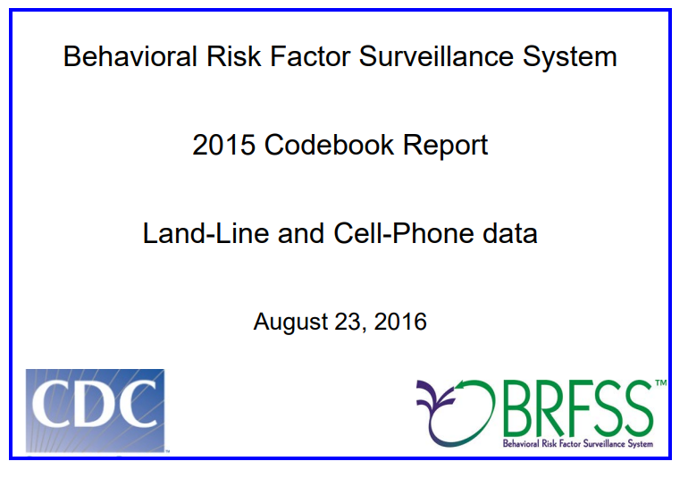
Data Dictionary of the Original BFRSS Dataset
Link to Codebook: https://www.cdc.gov/brfss/annual_data/2015/pdf/codebook15_llcp.pdf

Slide 5
Data Cleaning Process
Load data in RStudio
As a starting point, I select the column specifying if a particular observation has diabetes and columns that are commonly known to be associated with diabetes (same as the Diabetes Health Indicators Dataset from before)
Removed rows with missing values, we can do this without much data loss because we have over 400,000 observations
Recode and clean variables
Change yes to 1 and no to 0
Recode values to appropriate category
For factor variables, levels 7 and 9 indicate that the observation refused to answer the question. Therefore, recode this as NA.
E.g. For the diabetes variable, originally 1 described yes; 2 described yes; but only during pregnancy; 3 described no; 7 described don't know; 9 describes refused; blank described missing. So, I kept 1 to describe yes; however, I changed 2 and 3, to 0 to describe no diabetes.
Ensure that factor variables are stored as type factor (i.e. diabetes, high blood pressure, and general health) and numerical variables are stored as type numeric
Set seed and split randomly sampled an equal number of individuals who have and do not have diabetes this fix class imbalance issues.

Slide 6
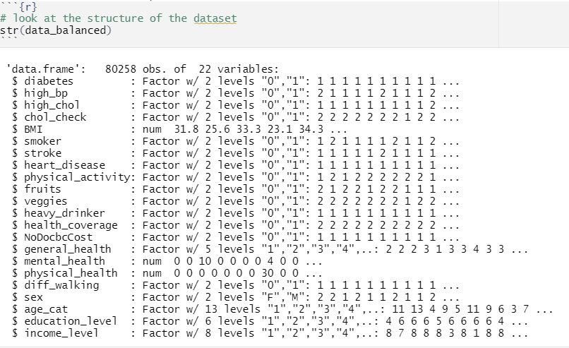
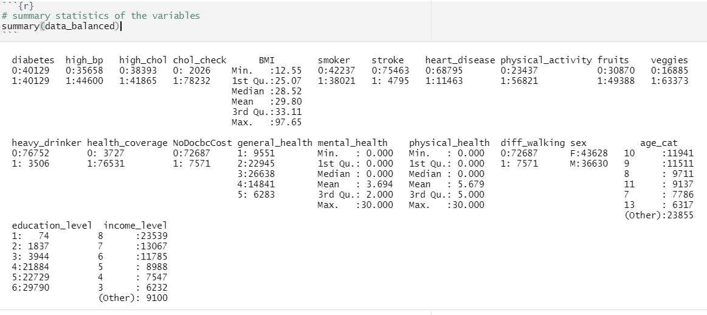
Cleaned Data Structure and Summary

Slide 7
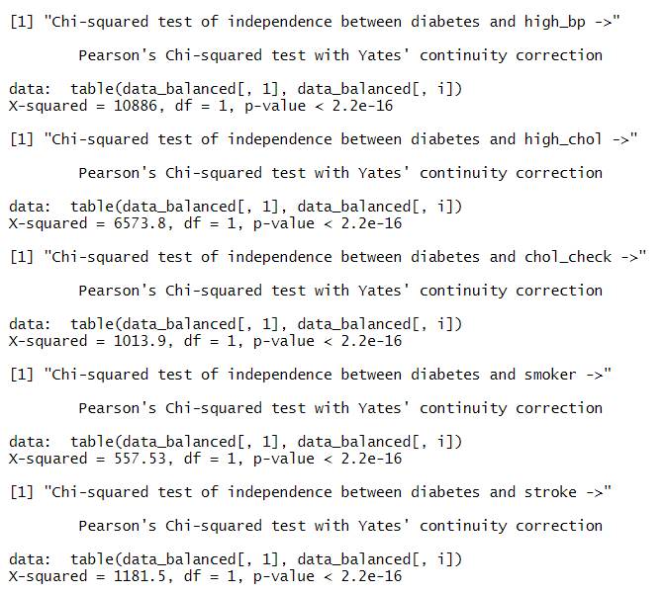
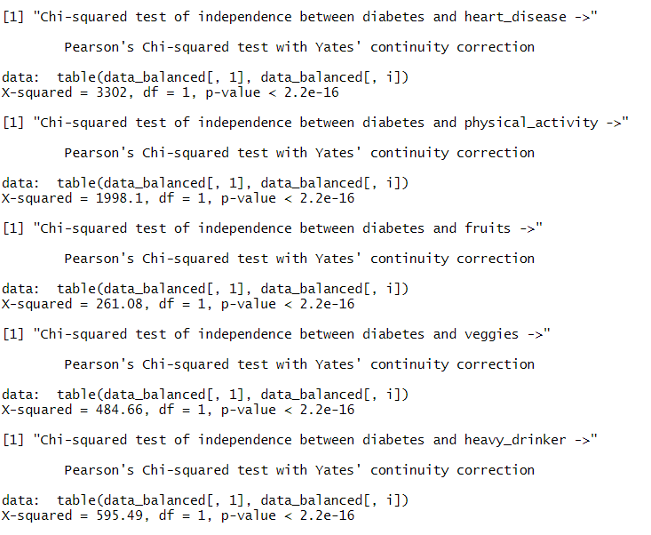
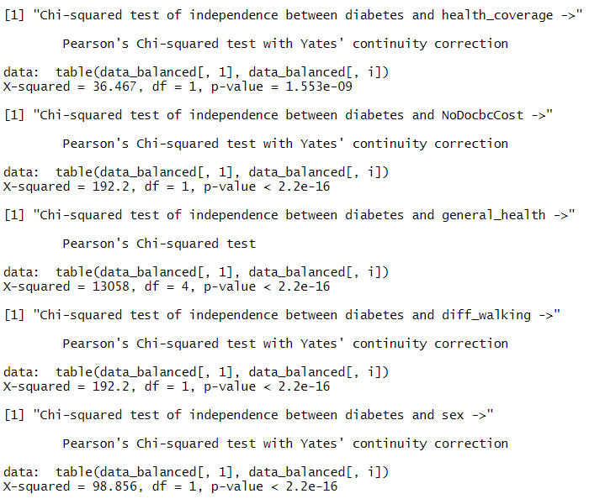
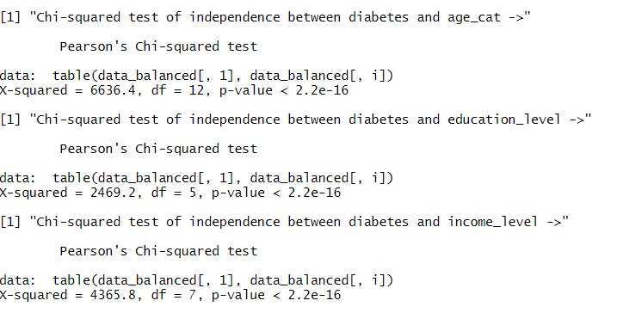
Hypothesis Testing for the Relationship between Factor Type Predictors and Diabetes

Slide 8
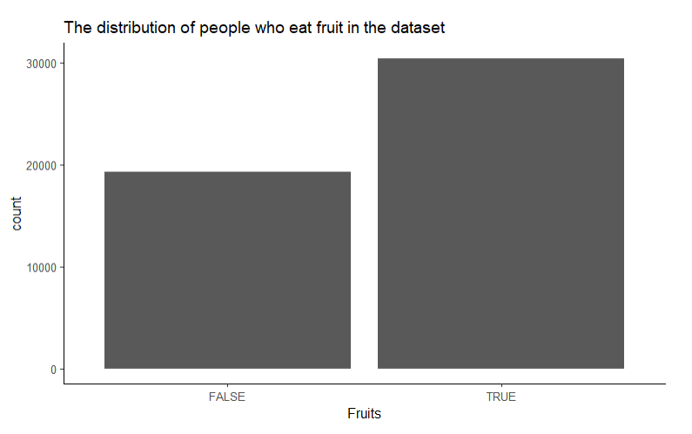
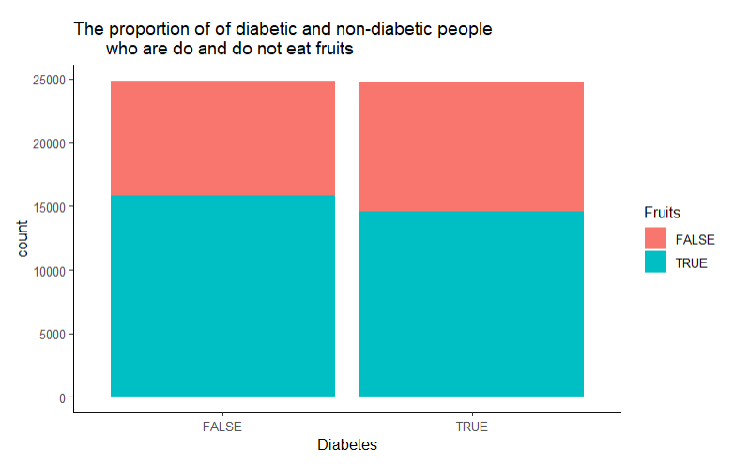
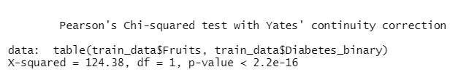
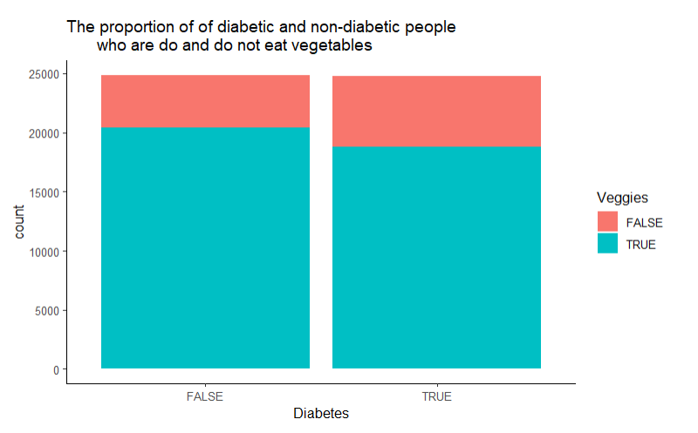
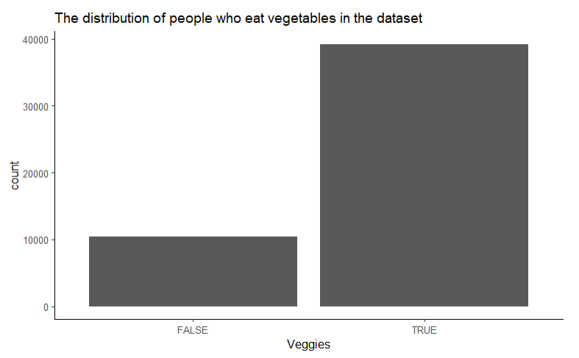
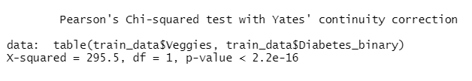
Exploratory Data Analysis Part 1: Diet

Slide 9
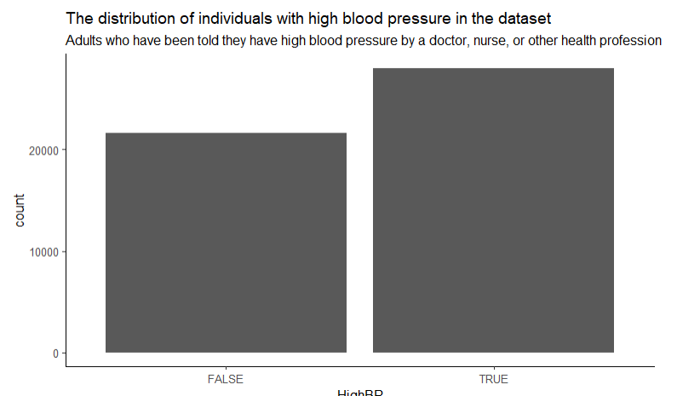
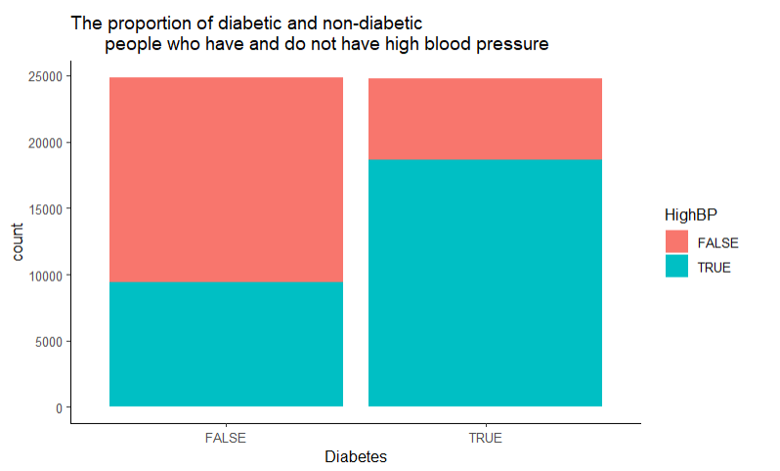

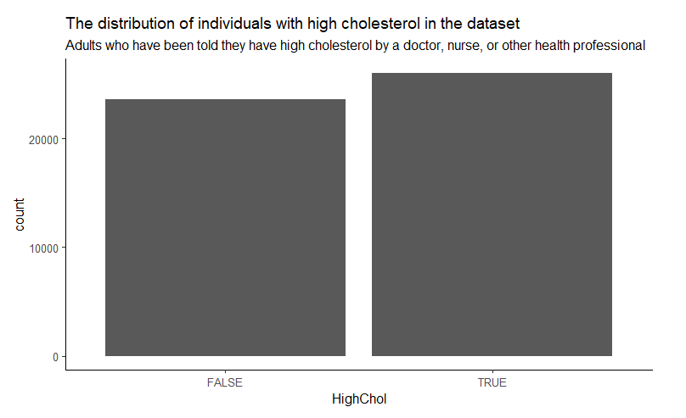
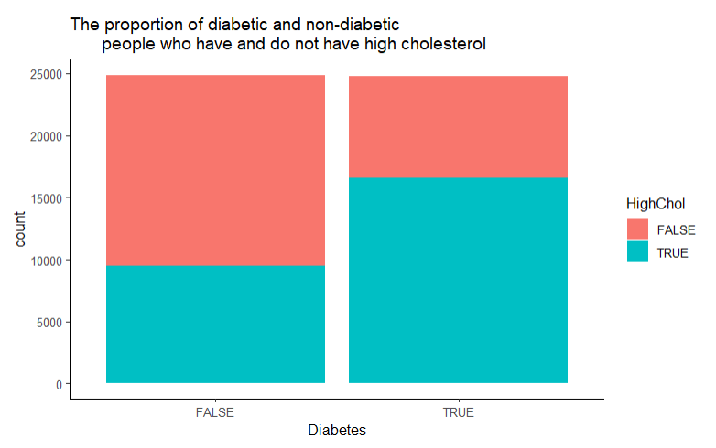
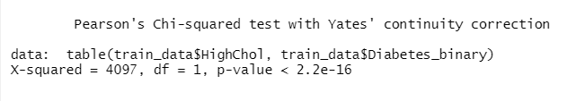
Exploratory Data Analysis Part 2: High Blood Pressure and High Cholesterol

Slide 10
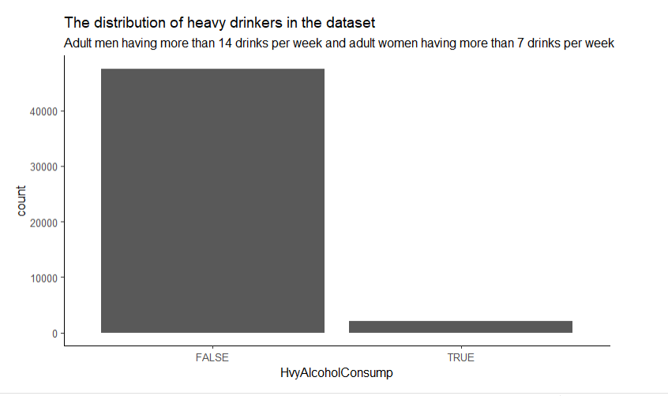
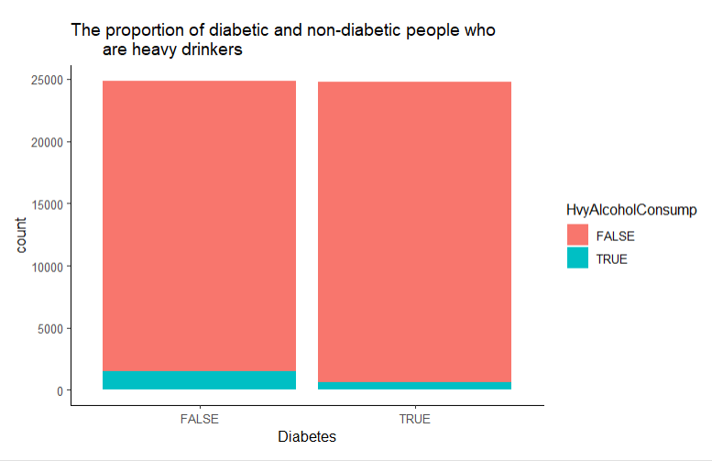
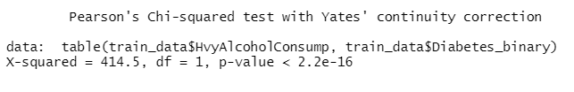
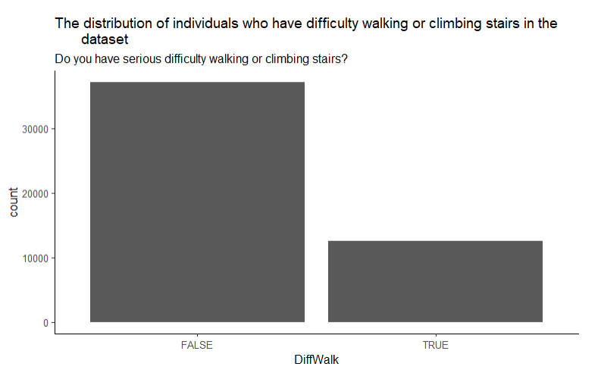
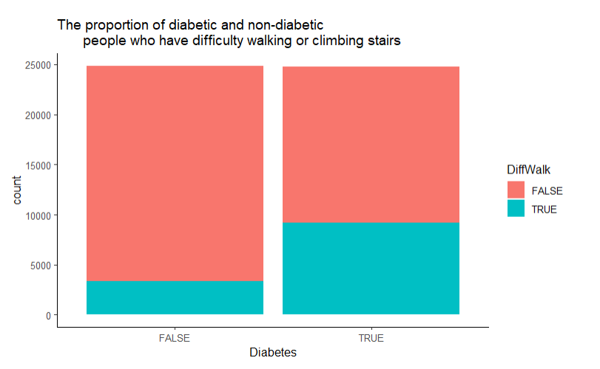
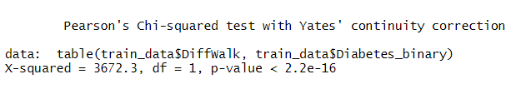
Exploratory Data Analysis Part 3: Heavy Alcohol Consumption and Difficulty Walking
Notes:
This is strange because alcohol has a lot of sugar, which can equate to diabetes. However, it makes sense that there are a greater proportion of non-diabetic people who are heavy drinkers than diabetic people because when people have diabetes, they do not want to drink because it might kill them. As a result, this variable might not be the best variable to continue on with our analysis. Also, this might be caused by the fact that so few observations are heavy drinkers. A better variable might be "have you been a heavy or binge drinker in the past".

Slide 11
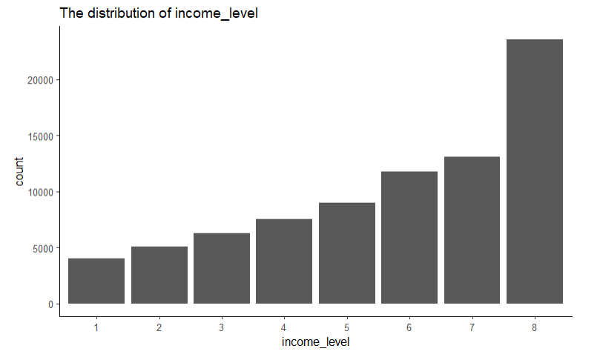
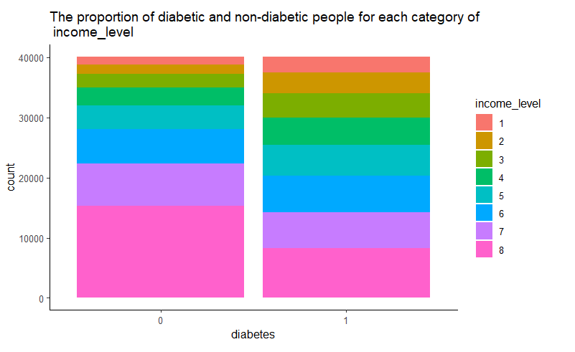
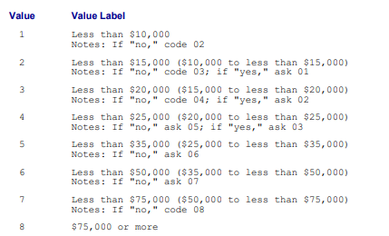
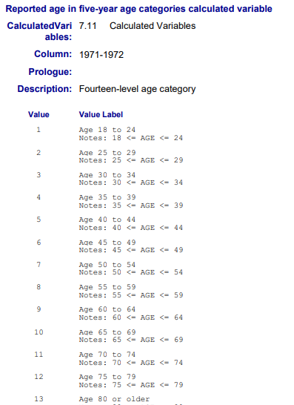
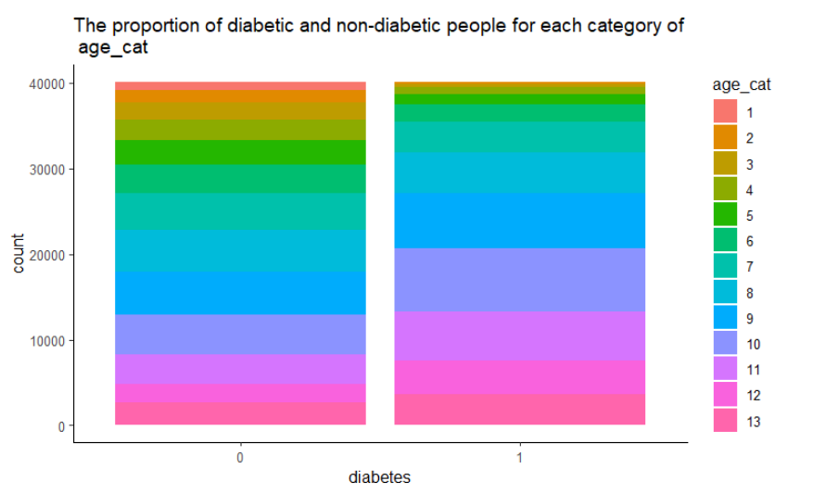
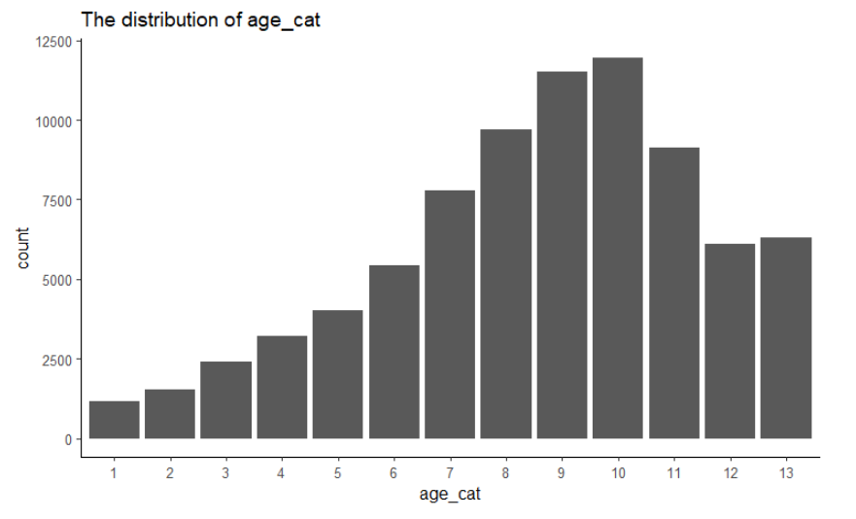
Exploratory Data Analysis Part 4: Income Level and Age Category
Notes:
This is strange because alcohol has a lot of sugar, which can equate to diabetes. However, it makes sense that there are a greater proportion of non-diabetic people who are heavy drinkers than diabetic people because when people have diabetes, they do not want to drink because it might kill them. As a result, this variable might not be the best variable to continue on with our analysis. Also, this might be caused by the fact that so few observations are heavy drinkers. A better variable might be "have you been a heavy or binge drinker in the past".

Slide 12
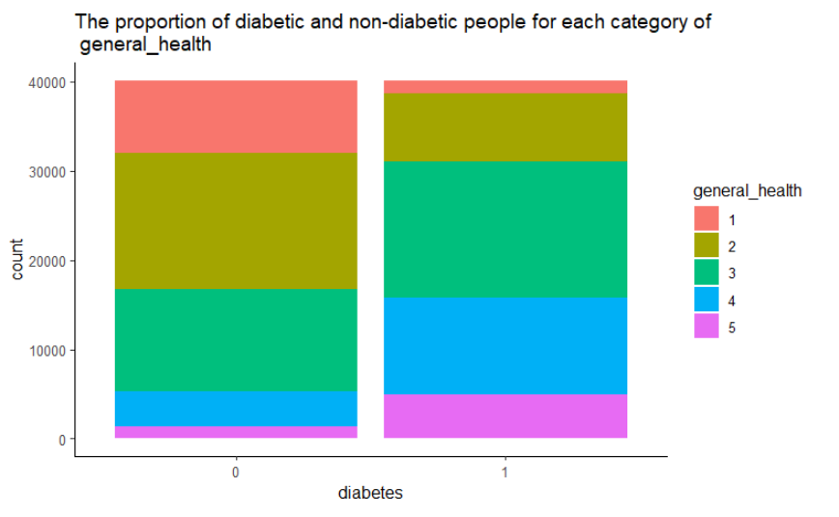
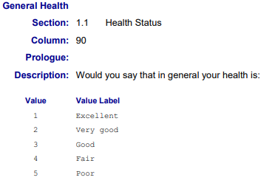
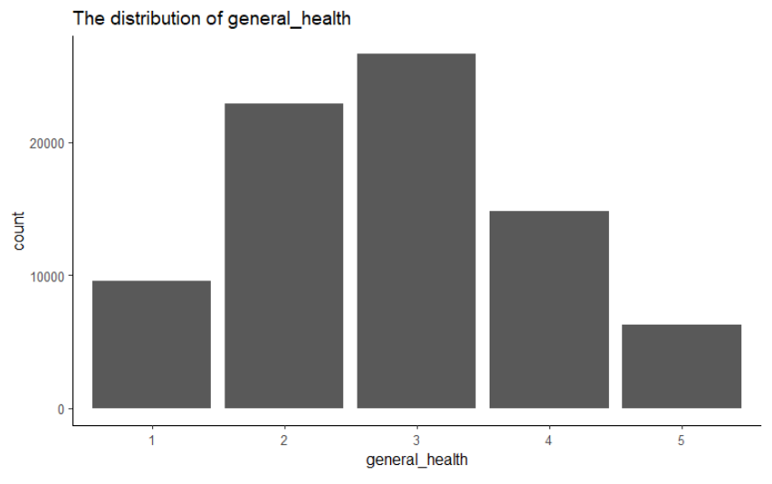
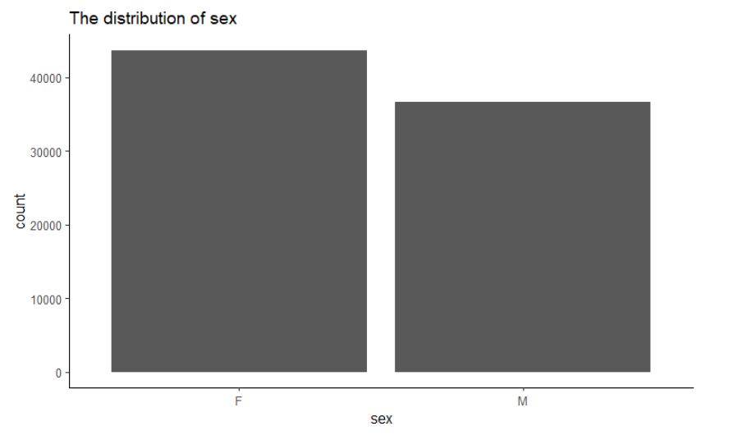
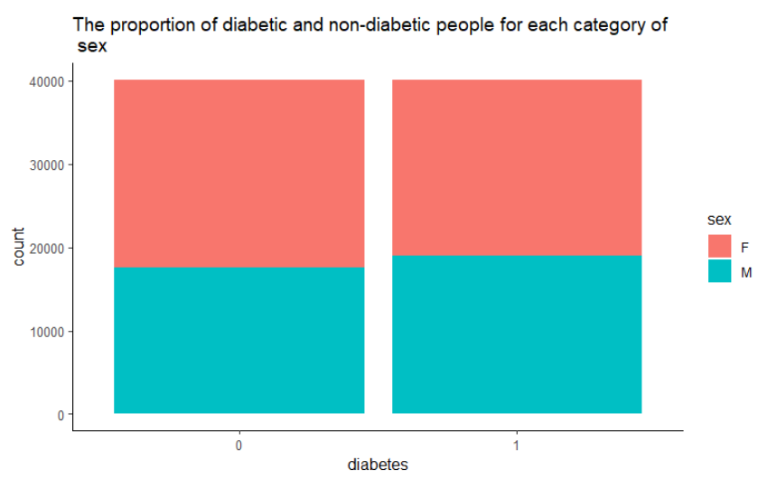
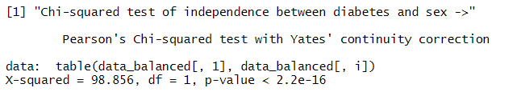
Exploratory Data Analysis Part 5: General Health and Gender
Notes:
This is strange because alcohol has a lot of sugar, which can equate to diabetes. However, it makes sense that there are a greater proportion of non-diabetic people who are heavy drinkers than diabetic people because when people have diabetes, they do not want to drink because it might kill them. As a result, this variable might not be the best variable to continue on with our analysis. Also, this might be caused by the fact that so few observations are heavy drinkers. A better variable might be "have you been a heavy or binge drinker in the past".

Slide 13
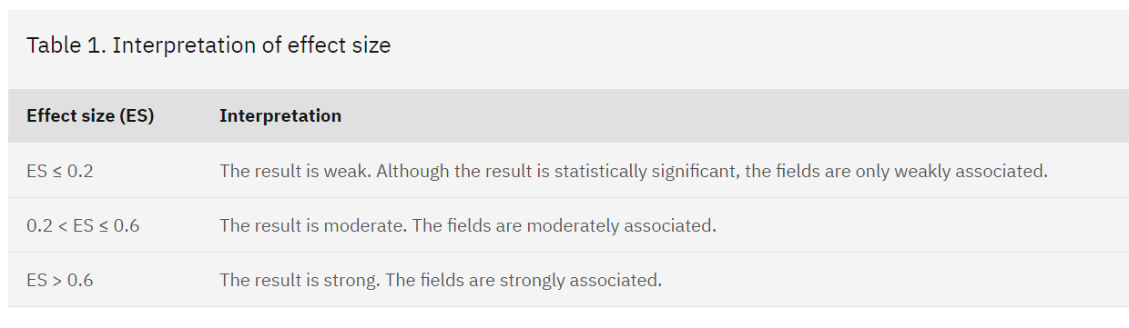
We will use Cramer’s V to measure the strength of the between factor variables
We will use this general guideline to measure strength between factor variables. Provided by IBM. Cramér's V - IBM Documentation

Slide 14
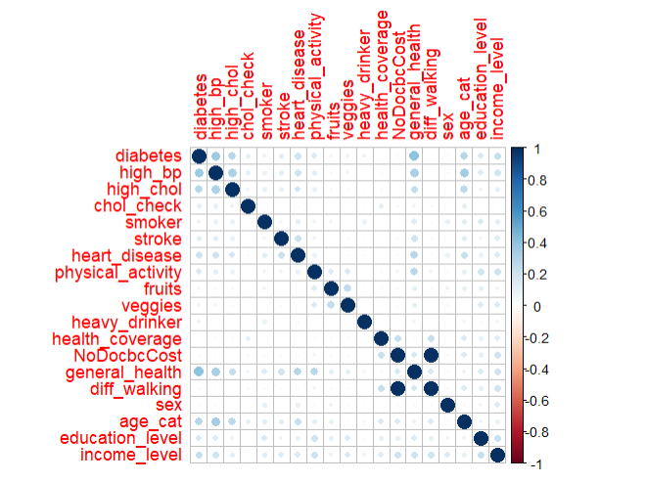
Relationships between the Factor Type Predictors and Diabetes. Also, Multicollinearity Among Factor Type Predictors:
Note: used Cramer’s V to measure how related the factor variables
Analysis - Relationship between Factor Type Predictors and Diabetes:
The factor type predictors that are most strongly related to diabetes with Cramer’s V > 0.2 are high_bp (0.36831274), high_chol (0.28622075), heart_disease (0.20287038), general health (0.40335672), age_cat(0.28755565), income_level(0.23323228)
Analysis - Multicollinearity Among Factor Type Predictors :
High_chol -> high_bp (0.31360472)
Heart_disease -> high_bp (0.20295323), Stroke (0.21907870)
Veggies -> Fruits (0.245024490)
NoDocbcCost -> health_coverage (0.229804631)
General_health -> high_bp (0.32292487), high_chol (0.24000009), stroke (0.20108227), heart_disease (0.28431391), physical_activity (0.27886606)
Diff_walking -> health_coverage (0.229804631), NoDocbcCost (1.000000000)
Age_cat -> high_bp (0.34303053), high_chol (0.26688979)
Conclusion:
Remove high_chol because high_chol closely related to high_bp, but high_bp has a stronger relationship with diabetes
Remove stroke because stroke is closely related to heart_disease and high_bp, but heart_disease and high_bp have a stronger relationship with diabetes
Remove fruits because fruits are closely related to veggies, but veggies have a stronger relationship with diabetes (0.077739849)
Remove health_coverage and NoDocbcCost because health_coverage and NoDocbcCost are closely related to Diff_walking, but Diff_walking is most closely related to diabetes
Remove general health because it is strongly related to many other variables. Although, general health is most closely related to diabetes, general health can simply be implied with other variables
Remove age_cat because it is associated with high_bp and high_chol.

Slide 15
Things to do:
Do more EDA: Hypothesis testing, analysis of numerical variables within the data, perhaps cluster or segment the data into groups based on demographic
Acquire at least 20 variables to train the model on that are not related with each other and
Complete Project Proposal

